Slide 1
Error Analysis
Significant Figures and Error Propagation

Slide 2
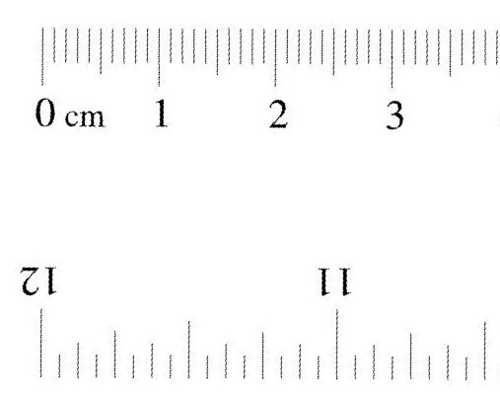
Instrument Reading
Try to guess to one digit beyond the smallest scale
A typical ruler is graduated to 1mm, read length to 0.1mm (thus the error is ±0.1mm)
For a digital instrument, the last digit is the uncertainty. For example 2.34g means (2.34±0.01)g.

Slide 3
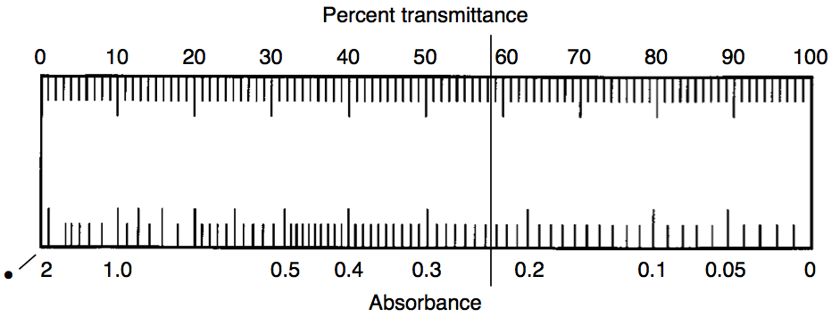
Examples
Absorbance: 0.234±0.001 (typical case)
Transmittance: 58.3±0.2 (judgment call: scale for transmittance too small to see clearly)

Slide 4
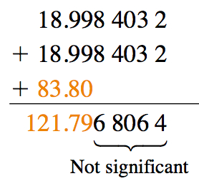
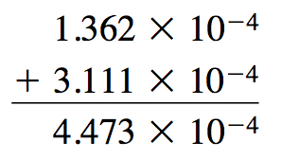
Arithmetic Addition and Subtraction

Slide 5
Scientific Notation
Express numbers to the same exponents during addition and subtraction.

Slide 6
Arithmetic Multiplication and Division
No need to express numbers to the same exponents during multiplication and division.

Slide 7
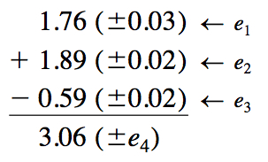
Propagation of Error Addition and Subtraction

Slide 8
Example

Slide 9
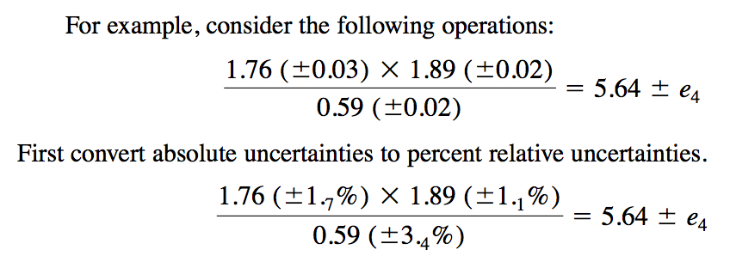
Propagation of Error Multiplication and Division

Slide 10
Example (Cont.)

Slide 11
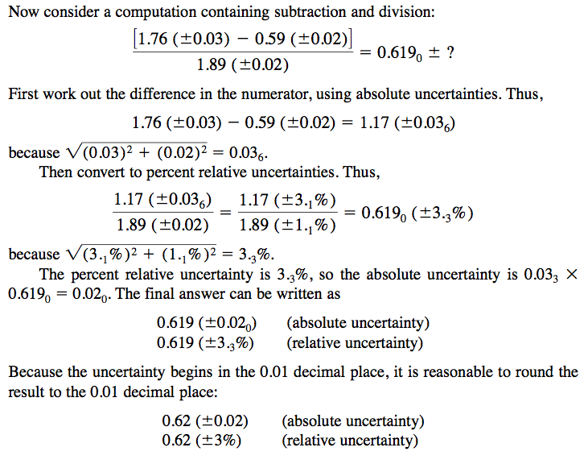
Mixed Operation

Slide 12
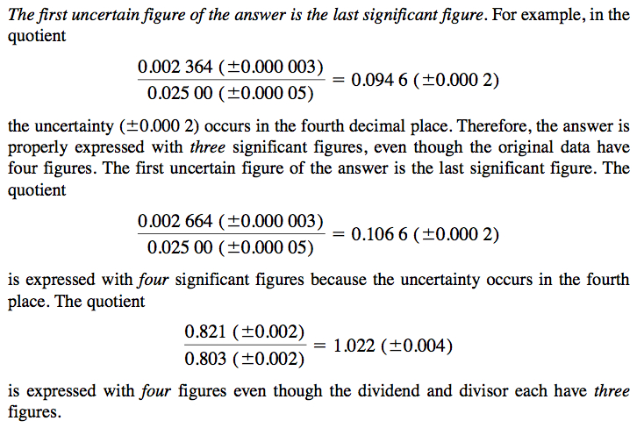
Changing significant figure

Slide 13
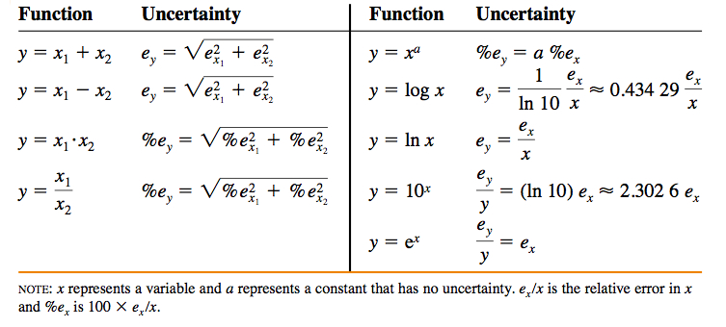
Summary

Slide 14
Exercise Significant Figures

Slide 15
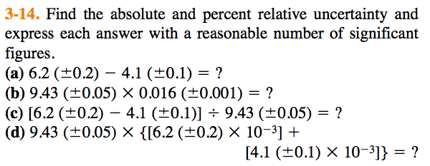
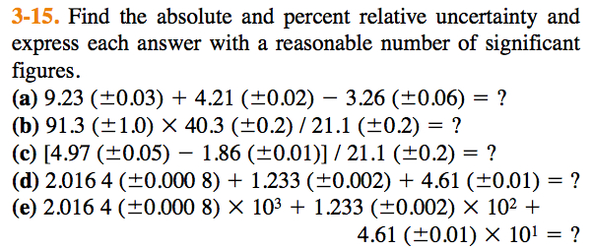
Propagation of Error

Slide 16
Credits
Most of the materials in this lecture is taken directly from:
http://chem35.files.wordpress.com/2007/11/ch03.pdf
Download and read the chapter directly for more details.

